Slide 2
Does Age Influence Educational Format Preference and Technology Adoption? Findings of a Survey of US Physicians
Andrew Bowser, ELS, CHCP – Director of Editorial Strategy
Alyce Kuklinski, NP, RN – General Manager
Rob McCarry – Senior Vice President and Executive Director Clinical Care Options

Slide 3
Learning Objectives
Upon completion, participant will be able to:
Discuss the impact of age on physicians’ preferences for online-, live-, and print-based educational formats
Describe the impact of age on the relative levels of adoption and comfort in the use of technology among US-based physicians
Develop educational activities that take into account the impact of age on physicians’ preferences for educational format and technology

Slide 4
Introduction
Alyce Kuklinski

Slide 5
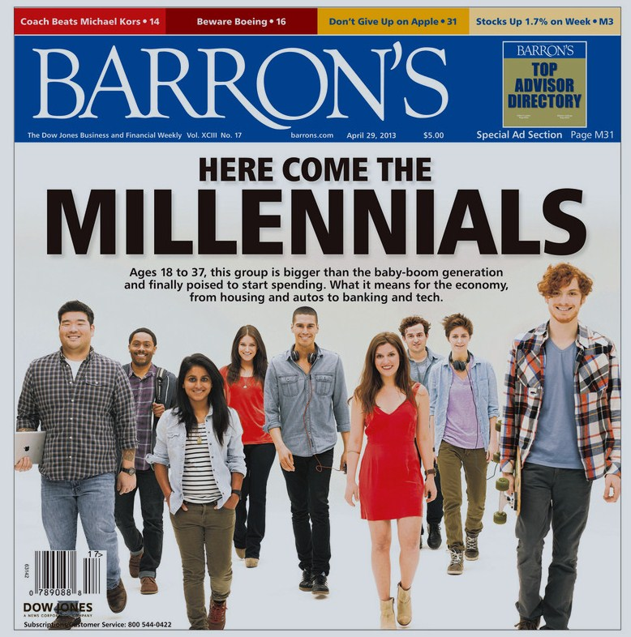
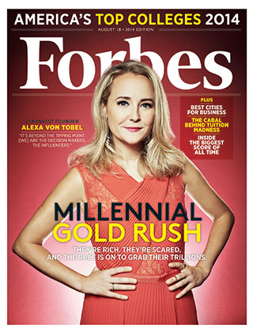
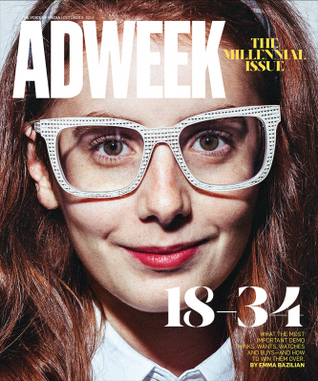
The Rise of “Millennials”

Slide 6
Characteristics of “Millennials”
Word cloud courtesy of Financial Times, February 25, 2015.Available at:
http://www.businesscircle.com.my/millennials-look-to-tech-stars-as-finance-careers-leave-them-cold/

Slide 7
Millennials and Health Care

Slide 8
Study Results
Andrew Bowser

Slide 9
Acknowledgement / Inspiration
“The Wild, Wild West of Clinician Education: The Generational Divide” – Carol S. Havens, MD, ACHEP 2015
Awareness of generational challenges in health education
Growing evidence about generational differences among learners

Slide 10
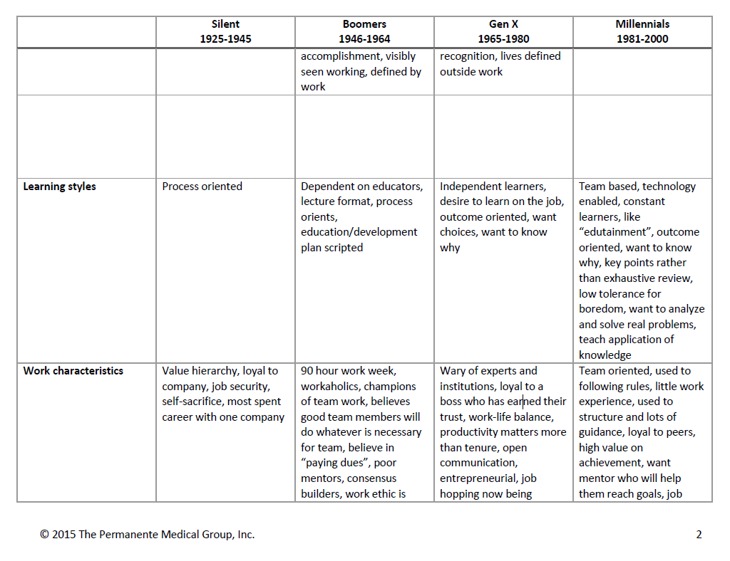
Havens, C. The Wild, Wild West of Clinician Education: The Generational Divide. ACEHP 2015.

Slide 11
Acknowledgement / Inspiration
“The Wild, Wild West of Clinician Education: The Generational Divide” – Carol S. Havens, MD, ACHEP 2015
Awareness of generational challenges in health education
Growing evidence about generational differences among learners
Follow-up question: what about generational differences specifically among adult learners in healthcare?

Slide 12
Background
Age presumed to play a major role in MD educational preferences
E.G., Millennials are tech savvy; therefore, Millennial MDs must be more adept at/receptive to technology-based educations interventions
Few data available to confirm such an inference
1. Elam CL, et al. Medical Science Educator. June 2011, Volume 21, Issue 2, pp 151-157.
2. Borges NJ, et al. Acad Med. 2006 Jun;81(6):571-6.

Slide 13
Background
Qualitative study to explore perceptions and attitudes of Millennial medical students (N = 23)¹
Millennial medical students prefer
Hands-on learning experiences in a non-competitive environment
Individualized feedback
Use of technology to manage information
Personality differences among Millennial and Generation X medical students (N = 809) at one medical school²
16 Personality Factor Questionnaire
Millennial students scored higher on factors such as reasoning, openness to change, and perfectionism
Generation X students scored higher than Millennials on self-reliance as a personality factor
1. Elam CL, et al. Medical Science Educator. June 2011, Volume 21, Issue 2, pp 151-157.
2. Borges NJ, et al. Acad Med. 2006 Jun;81(6):571-6.

Slide 14
What have others found?
ACP’s Medical Knowledge Self-Assessment Program
Young physicians, when preparing for high-stakes exams, don’t prefer text – they like multiple choice questions that can be presented quickly and reviewed in 1-2 minutes
Harvard Medical School: Revamping Curriculum to cater to a generation of tech-savvy students
Lectures going away; students will be expected to come to class ready to think on their feet and work in groups
Journal of Oncology Practice (2015): Younger physicians are substantially more likely to use Social Media

Slide 15
Aim
To address this gap, we prospectively surveyed our physician membership to understand how age impacts format and technology preferences

Slide 16
Methods
Online survey deployed to physician members
Age and other demographic factors recorded
Further questions sought learner preferences
Live, online, and print formats
Devices used (eg, laptop, smartphone)
Preferences rated from 1 (lowest) to 7 (highest)
Responses were aggregated into 5 age segments: youngest (24-35 years) to oldest (66-75 years)

Slide 19
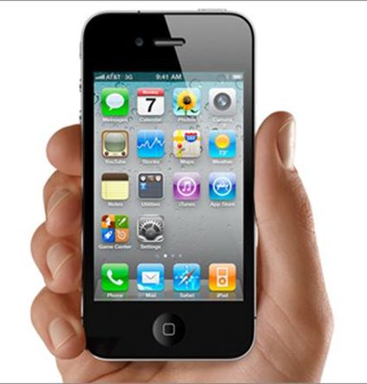
Results: Technology
Use of smartphone for educational activities
Nearly 70% of the youngest physicians (ages 24-35 years), vs about 25% for the oldest physicians (ages 66-75)

Slide 20
How Do You Currently Access CME Activities? PC/Mac vs Tablet vs Smartphone
Notes:
Among the youngest physicians (ages 25-35), 70% reported using a smartphone for educational activities, versus just 25% for the oldest cohort (ages 66-75).

Slide 21
What’s Your Primary (“Go-To”) Device for Looking Up Patient Care Information?
Youngest physicians: smartphone dominates
All other age groups: desktop dominates
But interestingly… older physicians were about twice as likely as younger physicians to report using a tablet as their “primary method”

Slide 22
Results: Online
Clear age-based trend in preference for webinars among younger physicians
Youngest physicians also reported a higher preference for online interactive cases vs older physicians
Oldest physicians expressed a lower interest in interactive tools providing expert guidance on best practice
Older physicians expressed a lower interest in podcasts vs younger physicians
Point-of-care resources scored high for all age groups

Slide 23
Results: Print/Text
Only 25% of the youngest physicians reported accessing CME in print format, vs nearly 60% for the oldest physicians
All age groups favored shorter text (a concise, 1000-word article) over longer texts
Younger physicians had a very low interest in comprehensive (eg, 10,000-word) texts

Slide 24
Print CME
Question: How do you access continuing educational activities? (Answer in %)
Notes:
Meanwhile, Millennials seem to be spending less time on CME at medical meetings and much less time on print CME

Slide 25
Results: Live Formats
Youngest physicians seemed less likely to be interested in attending live meetings at the local, regional, and national level
Some "novel" formats (flipped classroom and small-group breakouts) were ranked lower vs other live formats, regardless of age
Some “traditional” formats (ARS-based lectures, satellite symposia) were ranked highly by all age groups

Slide 26
Medical Meetings
Question: How do you access continuing educational activities? (Answer in %)
Notes:
Meanwhile, Millennials seem to be spending less time on CME at medical meetings and much less time on print CME

Slide 27
Results: CME Credit
Younger physicians more likely to report that claiming credit was not the key reason they participated in traditional continuing education activities
Likewise, younger physicians were less likely to be interested in the credit aspect of point-of-care resources

Slide 28
‘Millennial’ Physicians: Identified Preferences
Preference for concise, easily-retrievable educational formats that can be utilized at point-of-care (consistent finding across all physician age groups)
Less likely to attend live meetings (on regional and national scale)
Less motivated by credit offering
Higher appreciation for “edutainment”

Slide 29
Does Gender Matter?
Or, did other demographic factors impact technology or format preference?
Male vs. Female:
A few notable differences, eg, in preference for PoC activities and self-paced learning
Overall, however, a lack of differences between genders seems to indirectly emphasize the clear findings we saw with regard to generational differences

Slide 30
Comfort with technology-based activities: Men vs Women
Self-rated as “experts”
Women: 29%
Men: 42%
Later question:
“I am comfortable using Internet-based continuing education”
Completely agree: 67.6% women vs 63.1% men
Notes:
More men self-rate themselves as technology “experts,” despite similar levels of comfort with using Internet-based continuing education

Slide 31
Women
Men
Notes:
Women seem to express greatest enthusiasm for point-of-care activities

Slide 32
Ideal length of activity
No substantial differences observed
Men and women had similar ideas of how long an activity should ideally take
Webcasts
Reading online CME articles
Live local meetings
Etc.

Slide 33
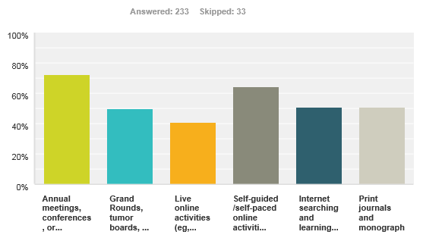
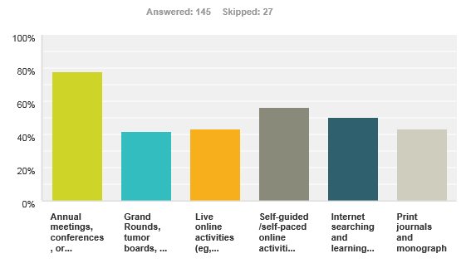
Setting where time is dedicated to completing CME/CE
Men
Women
64.4% vs 56.6%
Notes:
Men more likely to report using self-guided/self-paced online activities for completing CME

Slide 34
How do you most often access online information related to patient care?
No substantial gender difference
~30% laptop
~45% desktop
~15% smartphone
~10% tablet

Slide 35
Conclusions (Men vs Women)
Most variables analyzed suggest no impact of gender (male vs. female) on educational preferences and technology adoption levels
However, some signals observed:
More men self-rate themselves as technology “experts,” despite similar levels of comfort with using Internet-based continuing education
Women seem to express greatest enthusiasm for point-of-care activities
Men more likely to report using self-guided/self-paced online activities for completing CME
The fact so few differences were found seems to indirectly validate the pronounced differences between generations observed in the previous analysis
More research needed to determine what gender differences exist in educational preferences and technology adoption among MD consumers of physician-directed CME programs and point-of-care offerings

Slide 36
Conclusions
Age can be a predictor of physician preferences
Educational formats (online, print, and live)
Technology preferences (desktop vs mobile)
Younger physicians tend to report higher levels of technology comfort and adoption, and higher levels of preference for certain online activities
Health educators should take the age of the target audience into account when designing physician education, both in terms of educational format and technology preferences

Slide 37
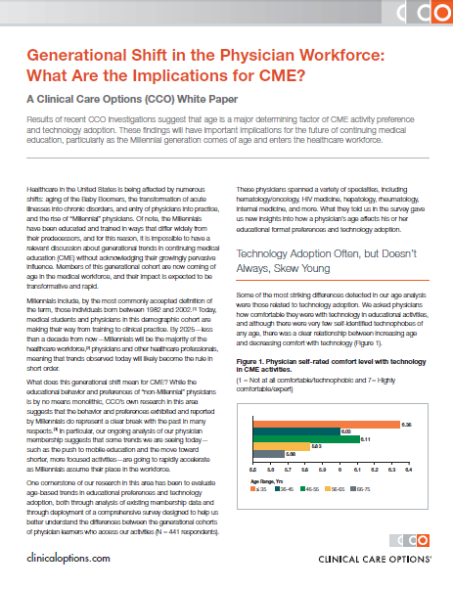
Available at: http://www.clinicaloptions.com/generational
“The move to mobile education and short, focused activities will rapidly accelerate as Millennial physicians enter the healthcare workforce.”
“One size does not fit all. Each physician has a unique preference for technology type and program format that cannot be defined simply by age alone, with the exception of the Millennials’ strong preferences for accessible education on smartphones and tablets.”
“If CME activities are to mirror the educational experience of Millennials, then they should be focused on easily retrieved, concise, and well-integrated clinical information/learning that is accessible on smartphones and tablets and comprehensive enough to be customizable to each physician’s learning needs.”

